Slide 1

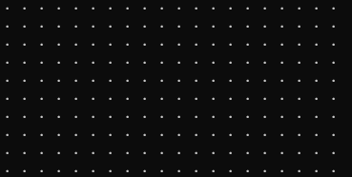
FINAL PROJECT PRESENTATION
Simple Pixel Art Editor in C
COURSE: CSE115 || SECTION: 04
Project of Group 6
Developed by: Abdul Hadi Kabir (ID: 2534257042)
&
Ahnaf Tahmid Islam (ID: 2532168042)
Submitted to: Mohammad Shifat-E-Rabbi (MSRb)

Slide 2
Project Overview:
What is it? | Why did we choose this?
Imagine "MS Paint," but built entirely with text characters in the console. | To master core C concepts. To apply 2D [arrays] for the canvas. To use loops (🔄 ) for drawing and displaying. To implement recursion for the "fill" tool.

Slide 3

Core Features:
Feature | Description
Custom Canvas Size 🖼️ | User can choose the size of the canvas
Drawing Tool ✏️ | Allows user to draw whatever symbol they want
Eraser Tool 🧼 | Erases the chosen symbol and replaces with ‘.’
Fill Tool | Can fill an area with the chosen symbol

Slide 4
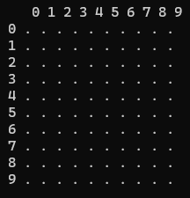
The Heart: Canvas
How the canvas loop functions works: initCanvas(): It loops through every "pixel“ of the array and sets it to a dot (.) and creates dynamically sized 2D array with the help of double pointers. displayCanvas(): It loops and printf’s the dots and the numbers. clearCanvas(): It replaces the character with a dot (.) in the rows and columns. freeCanvas(): It deletes the canvas from memory, so the program stays safe and clean.
initCanvas()
and displayCanvas():

Slide 5
The Drawing Engine (Part 1: Pencil &
Eraser)
We have built the engine functions that will power the editor:
drawPixel(x, y, color) Takes coordinates (x, y) and a character (color). Changes the designated [x][y] to that character. Includes boundary checks to prevent drawing outside the canvas. | erasePixel(x, y) A simplified version of draw. Resets canvas[x][y] back to the default dot (.).
✏️
🧼

Slide 6
The Drawing Engine (Part 2: The Fill Tool)
Paint Bucket
The "Paint Bucket" Tool: fillArea(x, y, target, replacement) | The "Paint Bucket" Tool: fillArea(x, y, target, replacement)
This is our most complex function. It uses Recursion (a function that calls itself) to spread. | Checks the current pixel (x, y). If it's the target color (e.g., '.'), it replaces it. Then, it calls itself for all 4 neighbors (Up, Down, Left, Right). This chain reaction fills an entire enclosed area.

Slide 7

User Guide:
Step | What happens
Choose Dimensions | Program allocates memory and creates a customized area for drawing
Draw | Can replace a singular dot with any symbol one at a time
Fill/Erase | Can fill an area of the user’s choosing and erase as well.
Resize | The canvas is cleared to a fresh and new canvas for the user to draw again

Slide 8
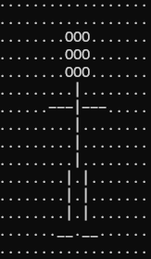
Output example
With the help of the user menu, you can use our draw and fill functions to create art like this:

Slide 9
🔧
Errors and fixes
Wrong coordinates | Shows error message if negative co-ordinates
Oversized canvas | Limited by recommended canvas size
Fill infinite recursion | Stops the fill tool from calling itself infinitely.
UI issue
The column numbers are not in line with the respective column dots which may cause confusion when finding the correct confusion. We plan to fix it in the future updates.
⚙️
👾

Slide 10
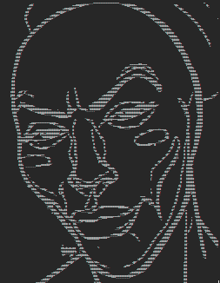
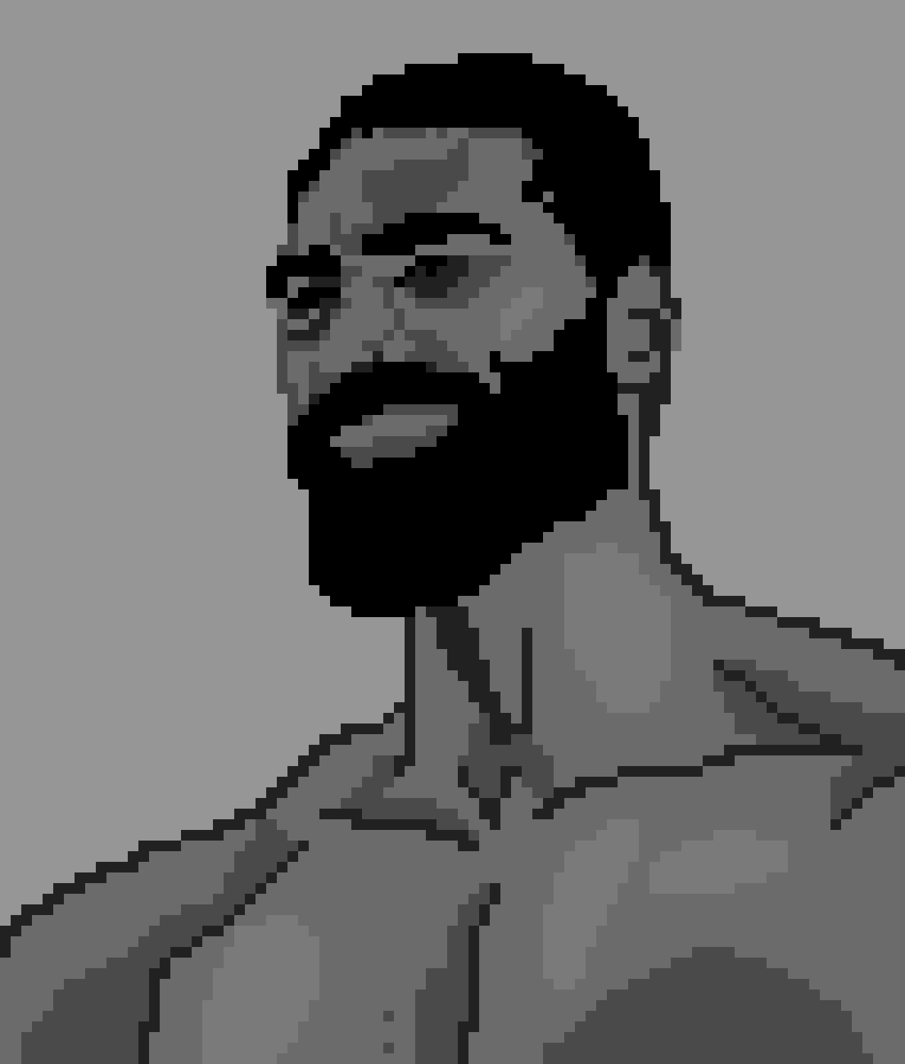
Future Improvements
Feature | What it do
Export art | Allow the user to save drawings
Undo/Redo | Fix any mistakes they make quickly
GUI | Support use of the mouse in drawing and use of colors
All these combined will allow creation of art like these:

Slide 11
Conclusion
We have a clean and functional code that is made with only the basics of C programming.
The UI is very user friendly.
The code allows a lot of room for new features and improvement in the future.
Our teamwork and distribution of workload according to our strength and weaknesses made the production smoother.
THANK YOU

